Slide 1
Shared Memory Multiprocessor
Muhammed Nur Aldin Halubi
2018556301

Slide 2
What is a multiprocessor ?
A multiprocessor is a data processing system that can execute more than one program or more than one arithmetic operation simultaneously because it contains multiple processors in the same CPU (typically called as cores in the CPU).

Slide 3
Advantages of Multiprocessing
01
It helps to improve the performance ratio of the system because many tasks can be run simultaneously, or the same task can be divided into many subtasks and get executed by many processors at the same time for execution speed depending on the system needs.
02
If an error occurs in one processor, a second processor may take up the responsibility of doing the task of the processor in which the error has occurred. This helps in enhancing the reliability of the system at the cost of some loss in efficiency.
03
It helps to divide the tasks among the modules. If physical failure happens, it is simple and cheaper to identify and replace the malfunctioning processor, instead of replacing the failing part of the whole complex processor.

Slide 4
connections in a multiprocessor
In a multiprocessor, components are connected with Interconnection Network that has many different structures, but its main task is networking processors with one another and with the main memory at the same time allowing data exchange among them.

Slide 5
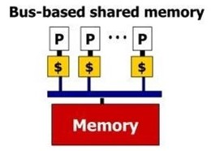
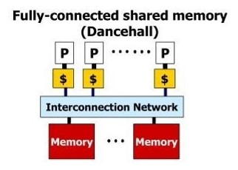
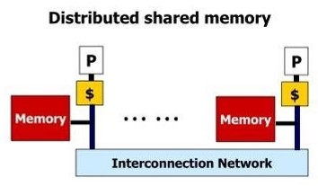
Memory Hierarchy in a Multiprocessor

Slide 6
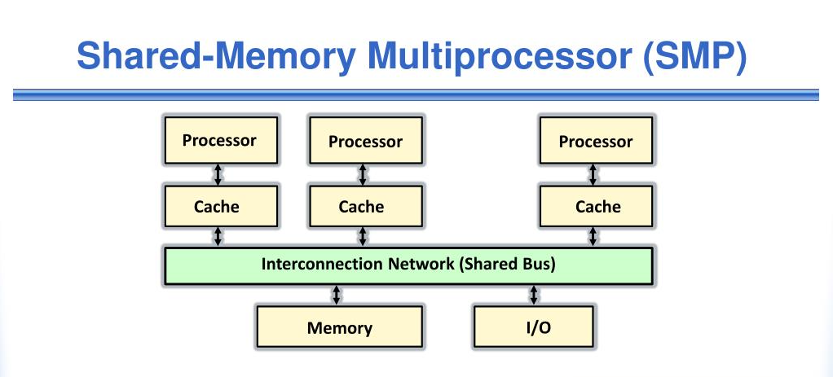
Symmetric Multi-Processor
Shared-memory multiprocessing (SMP) involves a multiprocessor computer hardware and software architecture where two or more identical processors are connected to a single, shared main memory, have full access to all input and output devices, and are controlled by a single operating system instance that treats all processors equally, reserving none for special purposes. Most multiprocessor systems today use an SMP architecture. In the case of multi-core processors, the SMP architecture applies to the cores, treating them as separate processors.

Slide 7
In current SMP systems, all processors are tightly coupled inside the same box with a bus or switch; on earlier SMP systems, a single CPU took an entire cabinet. Some of the components that are shared are global memory, disks, and I/O devices. Only one copy of an OS runs on all the processors, and the OS must be designed to take advantage of this architecture. Some of the basic advantages involves cost-effective ways to increase throughput. To solve different problems and tasks, SMP applies multiple processors to that one problem, known as parallel programming. However, there are a few limits on the scalability of SMP due to cache coherence and shared objects.

Slide 8
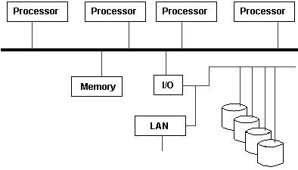
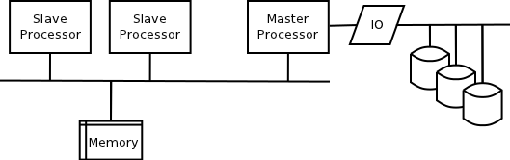
SMP VS ASMP
SMP
ASMP
All processors are treated equally so they have full access to all I/O devices and are controlled by a single OS instance that doesn’t reserve any processor for special purposes (in case of processor failure another processor can take over responsibilities of the failed processor, no major effect on the system).
Not all processors are treated equally. For example, a system might only allow one processor to execute operating system code or might allow one processor to perform I/O operation (If this processor fails the whole system may drop).

Slide 9
Thanks for listening!
https://www.tutorialspoint.com/what-is-multiprocessor
https://en.wikipedia.org/wiki/Symmetric_multiprocessing
https://www.slideshare.net/gaurav420/smp-and-asmp-architecture
http://image1.slideserve.com/2530761/memory-hierarchy-in-a-multiprocessor-n.jpg

